Slide 1
Development of Cyber Physical Layer to defend EV Systems from Cyber Attacks: Simulation based Twining Approach
ESE 534 Cyber Physical Systems Project
Deepi Singh
Reetam Mandal
Yash Patel
Stony Brook University
Oct 2020

Slide 2
Literature Review
Title | Achivements/Novelty | Limitations/Future Scope
M. Eckhart and A. Ekelhart, "Towards security-aware virtual environments for digital twins in", Proceedings of the 4th ACM workshop on cyber-physical system security, pp. 61-72, 2018. | Defined two rules, namely, safety and security rules, that specific digital twins must adhere to. | However, this research missed the synchronization between digital twins and the real systems. So real systems’ data is not incorporated into the implemented intrusion detection. Moreover, the proposed rules are very limited as an intrusion detection method for detecting cyber attacks.
M. Eckhart and A. Ekelhart, "A specification-based state replication approach for digital twins", Proceedings of the 2018 Workshop on Cyber-Physical Systems Security and Privacy, pp. 36-47, 2018 | Proposed a passive state replication to create synchronization between physical systems and digital twins that is a fundamental requirement for realizing the intrusion detection using digital twins. | This synchronization method only copy some limited data of physical system to digital twin and it does not make the digital twin able to follow the physical system continuously for instance, when there are unexpected changes in the physical system.
F. Akbarian, E. Fitzgerald and M. Kihl, "Intrusion Detection in Digital Twins for Industrial Control Systems," 2020 International Conference on Software, Telecommunications and Computer Networks (SoftCOM), 2020, pp. 1-6, doi: 10.23919/SoftCOM50211.2020.9238162. | The intrusion detection mechanism uses a combination of a Kalman filter to detect the attack, a particle swarm optimization algorithm to estimate the noise, and a support vector machine algorithm to classify the attack. | Applied on a ball and beam process. Scaling and Ramp attacks are addressed.

Slide 3
Continued….
H. V. Dang, M. Tatipamula and H. X. Nguyen, "Cloud-based Digital Twinning for Structural Health Monitoring Using Deep Learning," in IEEE Transactions on Industrial Informatics, doi: 10.1109/TII.2021.3115119. | 1.A cloud-based DT framework for SHM (cDTSHM) was proposed for real-time monitoring and proactive maintenance of civil structures. 2.The proposed method facilitates two-way mapping between physical structure and digital counterpart, as well as interaction among structure, machine, and human, paving the way towards a real-time intelligent monitoring system. 3.A layer of fog computing was implemented prior to the cloud layer to reduce the data volume and the computational demand for the digital model. | Relating/learning from DT applications in other domains: useful feedback from the digital replica can be improved by conceiving more other insights (e.g., control functions).
M. Milton, C. D. L. O, H. L. Ginn and A. Benigni, "Controller-Embeddable Probabilistic Real-Time Digital Twins for Power Electronic Converter Diagnostics," in IEEE Transactions on Power Electronics, vol. 35, no. 9, pp. 9850-9864, Sept. 2020, doi: 10.1109/TPEL.2020.2971775. | Real-time probabilistic digital twins embedded into controllers to comparatively monitor power electronic subsystems provide useful tools for online diagnostics of such systems. The custom PCE code generation library developed for this work provides means to create in C++ high-performance probabilistic digital twins, which can be synthesized for, and embedded into, FPGA-based controller designs. | Care must be taken to reduce model complexity, such as through the application and converter control layer equivalents, to ensure the digital twins are implementable with existing FPGA.
S. K. Mazumder et al., "A Review of Current Research Trends in Power-Electronic Innovations in Cyber–Physical Systems," in IEEE Journal of Emerging and Selected Topics in Power Electronics, vol. 9, no. 5, pp. 5146-5163, Oct. 2021, doi: 10.1109/JESTPE.2021.3051876. | Provides an overview of multiple research issues and challenges in these application areas and the solutions that are being pursued. The wide range of research topics presented in this review article is expected to provide an overview of ongoing research in power-electronics-based energy/power CPSs and help the researchers working in this area with the eventual aim of energy sustainability and smart power solutions.

Slide 4
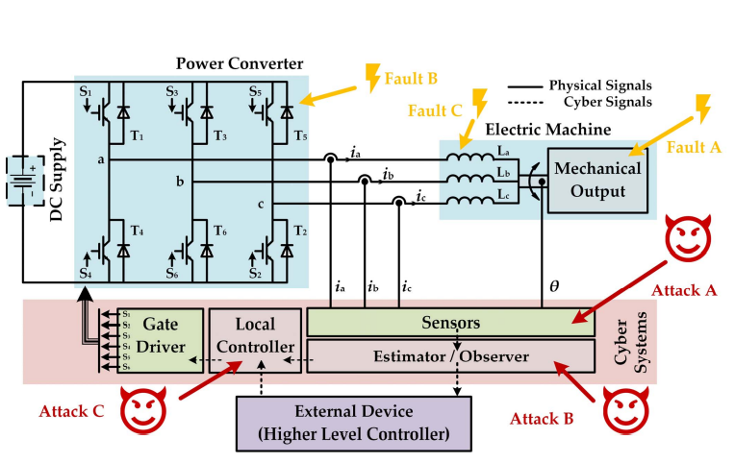
Literature Review Regarding different Vulnerable Points
Electric Drive System

Slide 5
Following are the different parts of a Electric Drive system with different modes of accessibility :
1 - SENSOR: There are two levels of SENSOR access. The first level is access to the sensors or wireless sensor network (WSN) and the second level is access to the out-of-band safety system, if one exists. Attacks against sensors or WSNs could be cyber or physical, with the goal being to inject data and lie about the system state or prevent communications. With access to the safety system, the adversary could either shutdown the movements in the targeted system or remove safety monitoring conditions in software to prevent safety mechanisms from shutting down the system. With access to either level, the adversary can control, disrupt or exfil data about the system’s operational status.
2 CONTROL: There are two levels of CONTROL access. The first level is access to the controller itself and the second level is access to the CONTROL-Inverter communications channel (i.e. network, serial bus protocols, PWM, etc.) between the controller and its drive controller(s). With controller access in the first level, the adversary can overwrite sensor data, spoof or stop logging in memory, and issue movement commands to the drive controller(s). With only communications access, the adversary may be able to exploit protocol vulnerabilities (i.e. ICS protocols or bus protocols) to inject, spoof or jam drive control commands to achieve a similar layer of access, but they will not be able to hide the attack or prevent user feedback. With access to the CONTROL-INVERTER communications channel, the adversary could also focus on moving laterally to the DRIVE layer. With access to either level, the adversary can control, disrupt or exfil data about the system’s operational status.

Slide 6
3 – POWER CONVERTER: There are two levels of CONVERTER access, but both require physical access. The first level is the drive controller itself and the second level is access to the CONVERTER-MOTOR channel. With controller access, the adversary could overwrite the configurations by flashing firmware or using a physically accessible management interface. Drives may be network accessible in some circumstances. With CONVERTER-MOTOR channel access, the adversary is limited to attacks on electrical current fed to the EM. With access to either level, the adversary can control or disrupt movement.
4- MOTOR- An adversary should be able to access the MOTOR layer with physical access. Digital motors, specifically digital servos, can be reprogrammed and have firmware overwritten. Physical access may be an insider threat scenario in restricted areas, but in moving systems this may not always be the case if the target system is parked outdoors or publicly accessible. With access to this layer, the adversary can disrupt movement.
SENSOR Layer Experimentation The SENSOR layer has two levels of attacks: (1) attacking the sensor input and (2) attacking the safety system. We include a single example experiment targeting an accelerometer that is used for servo control as safety systems vary in their size and scope 4.2.1 SENSOR Attack: Accelerator Data Injection This experiment is designed to demonstrate an adversary taking advantage of trusted input provided by a sensor. The attack shows on disrupting communications between an accelerometer and the controller communicating over an I2C bus

Slide 7
CONTROL Layer Experimentation The CONTROL layer has two levels of attacks: (1) attacking the movement commands at runtime; and (2) attacking the CONTROL-DRIVE channel. We provide an experiment for each attack level. 4.3.1 CONTROL Attack 1: Timing Impacts of Discrete Command Injections on Motor Control This attack is designed to show the impacts of the timing of injected commands against a controller using two different examples and the approach launching for more finely tuned control attacks.
CONTROL Attack 2: Hardware Implant Targeting PWM Channel This experiment shows a control injection attack on PWM using the CONTROL-INVERTER channel by introducing a hardware implant to disrupt the control signal and take over motor control. PWM is not authenticated and a pulsating control signal caused by a hardware switch that fluctuates the voltage, usually between 0 and 3.3V or 5V. The ESC and motor receive current from an external power source, so the controller does not provide any current through this channel. This is a typical setup used to control applications that use ESCs to drive the motor, such as recreational vehicles, drones, and small personal electric vehicles such as electric skateboards. 15 In many motor applications, a 3-wire control channel is used to provide instructions to the drive controller from the receiver or embedded controller. This wire does not always used to provide live power and may also be used for control, such as with ESCs. Usually, the three wires are ground (black), power (red), and control (white or yellow).

Slide 8
Inverter Layer Experimentation The Inverter layer has two levels of attacks: (1) attacking the systems movements through firmware or with the ability to modify the configuration parameters, and (2) attacking the INVERTER-MOTOR channel. We provide example attack experiments for level 1, using pin control and pin configuration attacks at the drive controller. Level 2 attacks are limited to short-circuiting the connection or pulling leads, which should be detected by safety and overload protections, so an example experiment is not provided.
Attack1: Pin Control and Configuration Attacks
Attack 2: Modify Clock and Duty Cycle
Attack 3: Capturing Movement Commands in Memory

